Slide 1

Forensics Workshop: Learn Foundational Crime-Solving Skills and How They Have Solved Cases of Injustices
Authors: Denise M. Dragos & Suzanna E. Schmeelk
Affiliation: St. John’s University – Queens, New York (United States)
Session: Workshop 2:30pm – 4:30pm on March 18, 2023

Slide 2
Forensics Workshop: Learn Foundational Crime-Solving Skills and How They Have Solved Cases of Injustices
Introductions & University Background
DFR Introduction
Case Overview
Crime Scenes to Arrests with Exercises
The Trial
Conclusions & Attendee Survey
Support material available at:
https://dmdragos.github.io/WiCyS-2023

Slide 3
Denise Dragos, M.S.
Assistant Professor, St. John’s University
Doctoral Candidate, Pace D.P.S. Computing
Private Consultant, NYS Lic. Private Investigator
Manager, KPMG LLP, NYC Forensic Lab
Detective (ret.), NYPD Computer Crimes Squad
GIAC GSEC Gold, GCIH, GREM
CISSP, CCO, CCPA, and Security+

Slide 4
Suzanna Schmeelk, Ed.D.
Assistant Professor, St. John’s University
D.P.S. in Computing
Ed.D. in Mathematics
M.S. & B.S. in Computer Science/ Cybersecurity
Memorial Sloan Kettering Cancer Center InfoSec
Alcatel Lucent / Bell Labs
Numerous publications and presentations

Slide 5
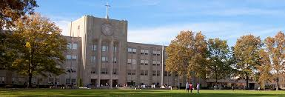
St. John’s University - Queens Campus
- Nearly 100 acres, over 16,000 students enrolled
- Over 4500 students live on college run properties
- Queens county, most culturally diverse county in contiguous United States

Slide 6


St. John’s Cybersecurity Programs
Cybersecurity BS Program – UG Major and Minor
Digital Forensics Program – UG Minor (Planned Major)
Cyber and Information Security – MS Program
Technical, Managerial, and Data Mining tracks
ABET Accredited & DHS/NSA Designated Center of Academic Excellence in Cyber Defense (CAE-CDE)
Four full time faculty members, cross-disciplinary professors, industry professional adjuncts

Slide 7
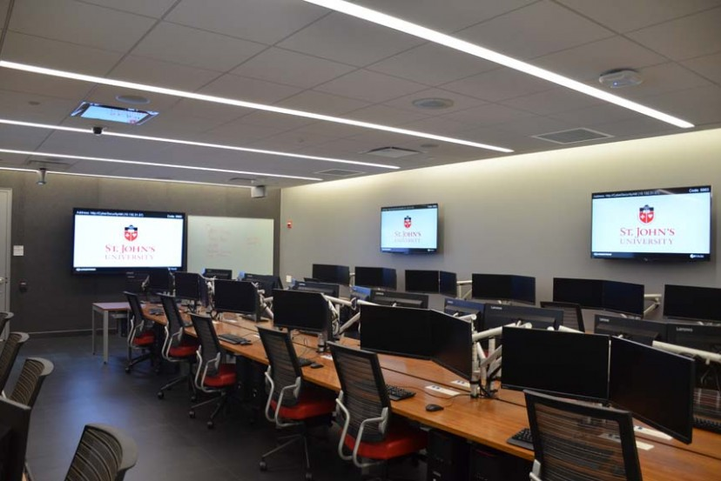
CCPS Lab Facilities
Sanford Family Cybersecurity Lab
Homeland Security/
Emergency Management
Simulation Lab
Innovation Lab
Computer Science Lab

Slide 8
Digital Forensics (DFR) Primer
What is digital forensics? (TechTarget)
Digital forensics is the application of investigation and analysis techniques to gather and preserve evidence from a particular computing device in a way that is suitable for presentation in a court of law.
The goal of computer forensics is to perform a structured investigation and maintain a documented chain of evidence to find out exactly what happened on a digital device and who was responsible for it.
We seek justice for crime victims, such as the heinous attack and killing in NYC of Michael J. Sandy – conviction of perpetrators for hate crimes.

Slide 9
Digital Forensics
Traditional “dead box” forensics
OS / Filesystem
“Live” System Analysis
Memory Forensics – RAM analysis
Networks Forensics
Wired vs. Wireless
Device and traffic analysis
Cloud
Mobile Devices / IoT Devices / Vehicles / Wearables / …..

Slide 10
Digital Evidence- Order of Volatility (RFC 3227, 2002)
registers, cache
routing table, arp cache, process table, kernel statistics, memory
temporary file systems
disk
remote logging and monitoring data that is relevant to the system in question
physical configuration, network topology
archival media

Slide 11
Legal Aspects of Digital Forensics
Fourth Amendment to the U.S. Constitution protects everyone’s right to be secure from search and seizure
Federal Rules of Evidence
Jurisdictional Issues – Federal vs. State vs. Local vs International
Authority to Search
Consent
Search Warrant
Court Order
Subpoena
Exigent Circumstances
Public Sector vs. Private Sector

Slide 12
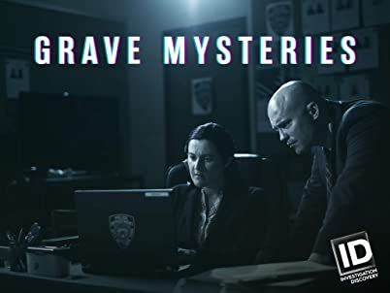
Grave Mysteries – Death on the Highway

Slide 13
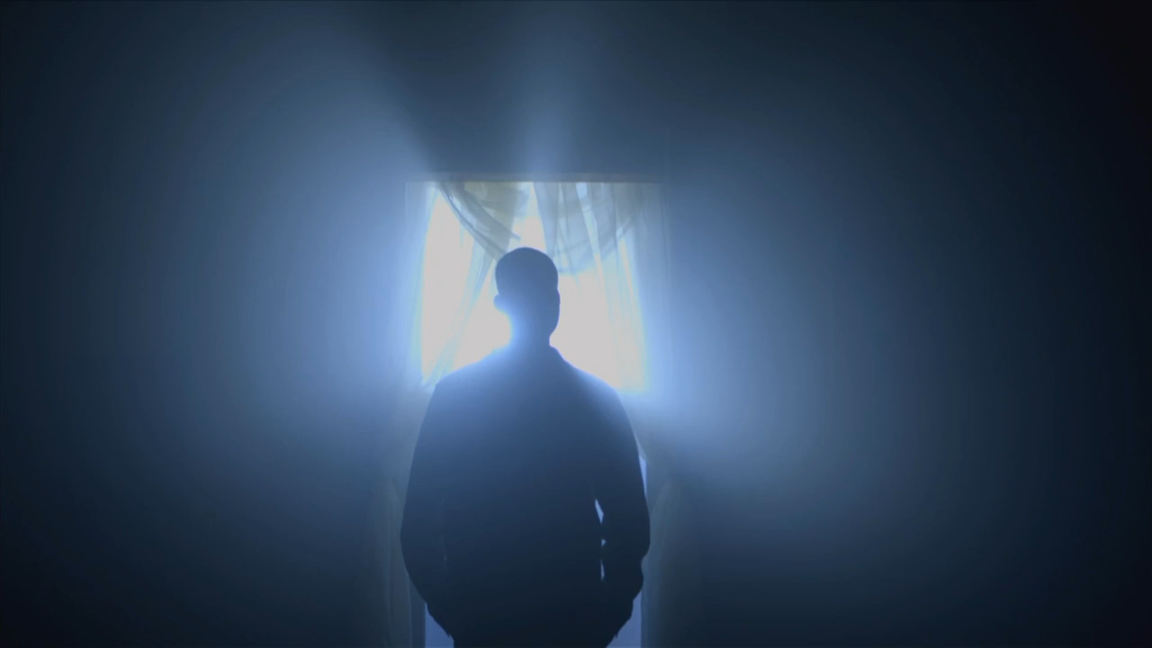

Slide 14
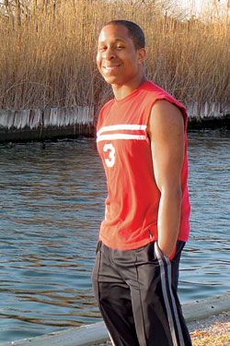
Michael Sandy
Michael J. Sandy, born 10/12/1977, originally from Bellport, NY
Lived in Williamsburg, Brooklyn
On October 8, 2006, Michael (age 28), met someone in online chatroom on website Adam4Adam
Conversation moved to AOL Instant Messenger where they discussed meeting up - talk was very explicit in nature.

Slide 15
Case Overview – 10/8/2006
Michael drove to meet up with his new acquittance in Sheepshead Bay, but after seeing a few extra people, got spooked and drove off
Shortly later, Michael messaged FisheyeFox again to meet him alone
He returned and they headed over to Plumb Beach together
He was Attacked by several white men and chased into the highway
Michael was hit by car (that never stopped). They dragged him onto shoulder and rifled through his pockets.
On Friday,10/13/2006, after five days in a coma, Michael was taken off life support and died. It was the day after his 29th birthday.

Slide 16
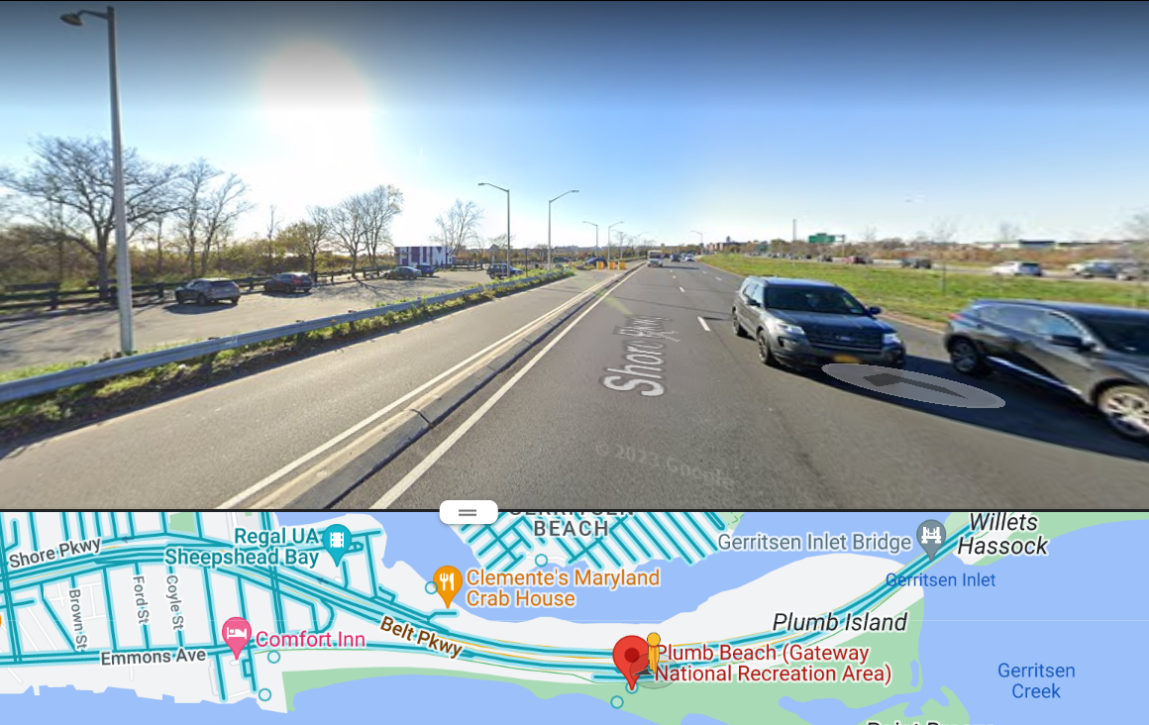
Plumb Beach

Slide 17
Initial Computer Crimes Response – 10/9/2006
On October 9, 2006, we received a call for assistance from the 61st Precinct Detective Squad for a robbery investigation
Michael Sandy was found unconscious on the side of the highway when police arrived, but Detectives were able to locate his wallet and running car
At Michaels residence, his computer was on and still logged into AOL with open chat windows.
I was tasked with documenting and preserving evidence from Michael Sandy’s home computer

Slide 18
Live Analysis of Windows Laptop
Michael’s residence, his laptop running Windows XP (SP1) was logged into AOL with an open chat conversation between DrumNBass007 (Sandy) and FisheyeFox.
Chat conversation was first saved directly to USB drive as .txt and .rtf file
Digital photos also taken of the screen and PC setup
Helix3 Live CD was then used to process the system and do RAM Dump
Once live analysis was complete, the laptop was taken into custody, invoiced and transported back to CCS Lab for further analysis

Slide 19
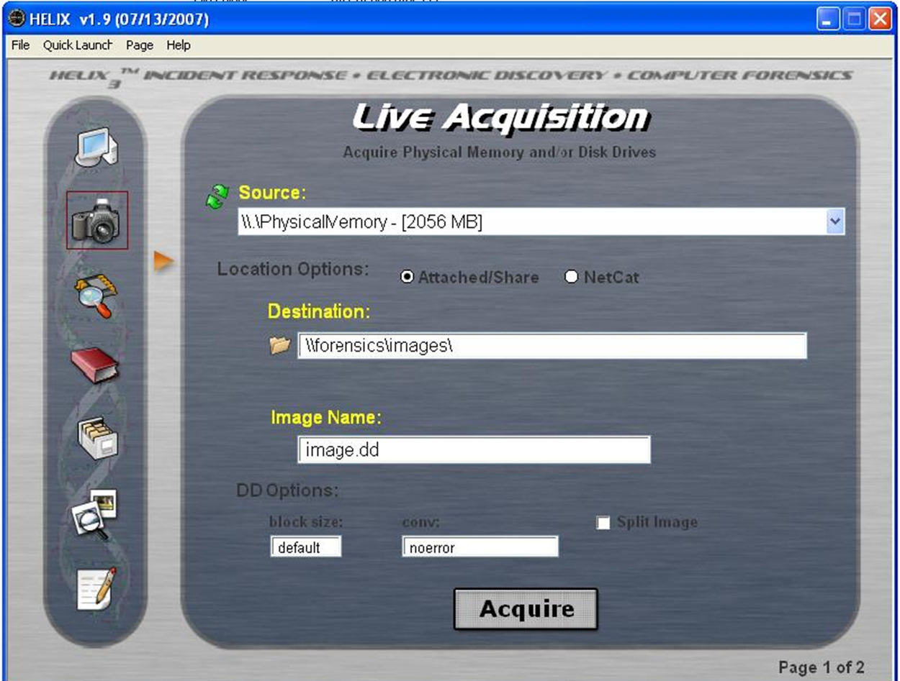
Helix Live Memory Acquisition

Slide 20
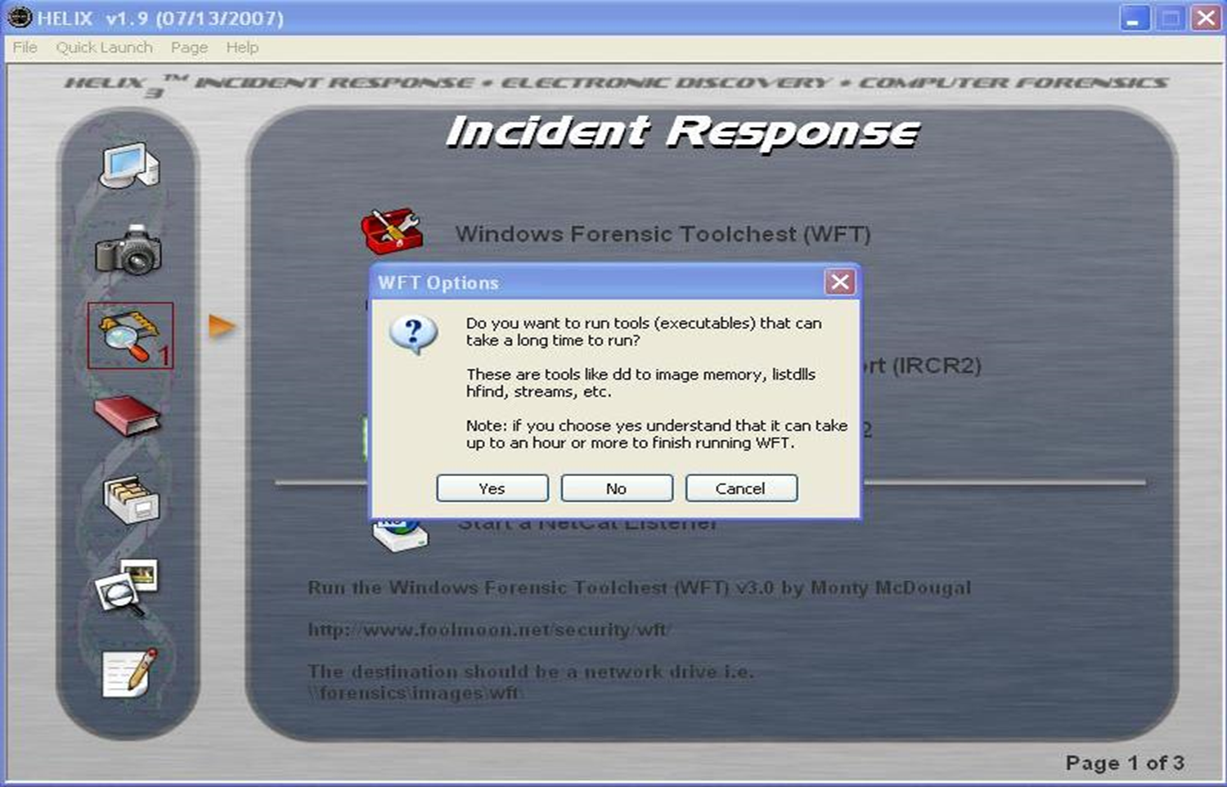
Helix Live System Analysis - WFT Processing

Slide 21
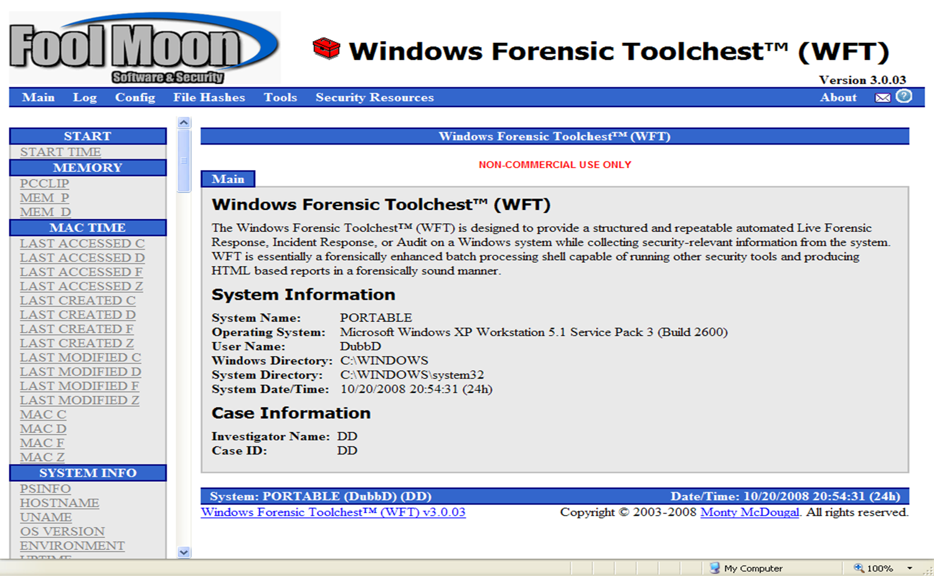
Windows Forensics Toolchest (WFT)

Slide 22
Live System and Memory Analysis – Exercise – 15 min.
Download Live.zip from Repo, unzip in folder on desktop
Review Batch.bat in a Text Editor
Run batch file and follow prompts
Review Results
Additional system analysis can be done with FireEye Redline, Magnet Forensics Response, or other CLI tools.
Further Memory analysis with Redline, Autopsy, or Volatility.
Manual mem dump analysis can be done with BinText, Strings, or NetAnalyzer.
Plethora of commercial tools available also.

Slide 23
Exigent Circumstances
FisheyeFox AOL account was still connected and ‘online’
Analysis of chat content indicated that victim was targeted based on lifestyle
Violent attack witnessed by passersby
Coordinated with CCS Office to expedite contact with ISPs
Emergency request made to AOL for subscriber and connection log data
AOL account registered to John Fox, of Sheepshead Bay. The connection IP – Optimum Cable, additional subpoenas sent out.

Slide 24
OOL Subpoena Results
Subpoenas must reference specific:
XXX.XXX.XXX.XXX on Date at HH:MM:SS zST/zDT/GMT/GMT Offset
Received Subscriber and Billing Information for IP Connection log data covering time of conversation
CME and CPE MAC Addresses
Received within ½ hour of initial request
Residence several blocks from crime scene
Bringham St. Sheepshead Bay, BK, NY
Shared information with Case Detectives
CCS Responded back to Brooklyn

Slide 25
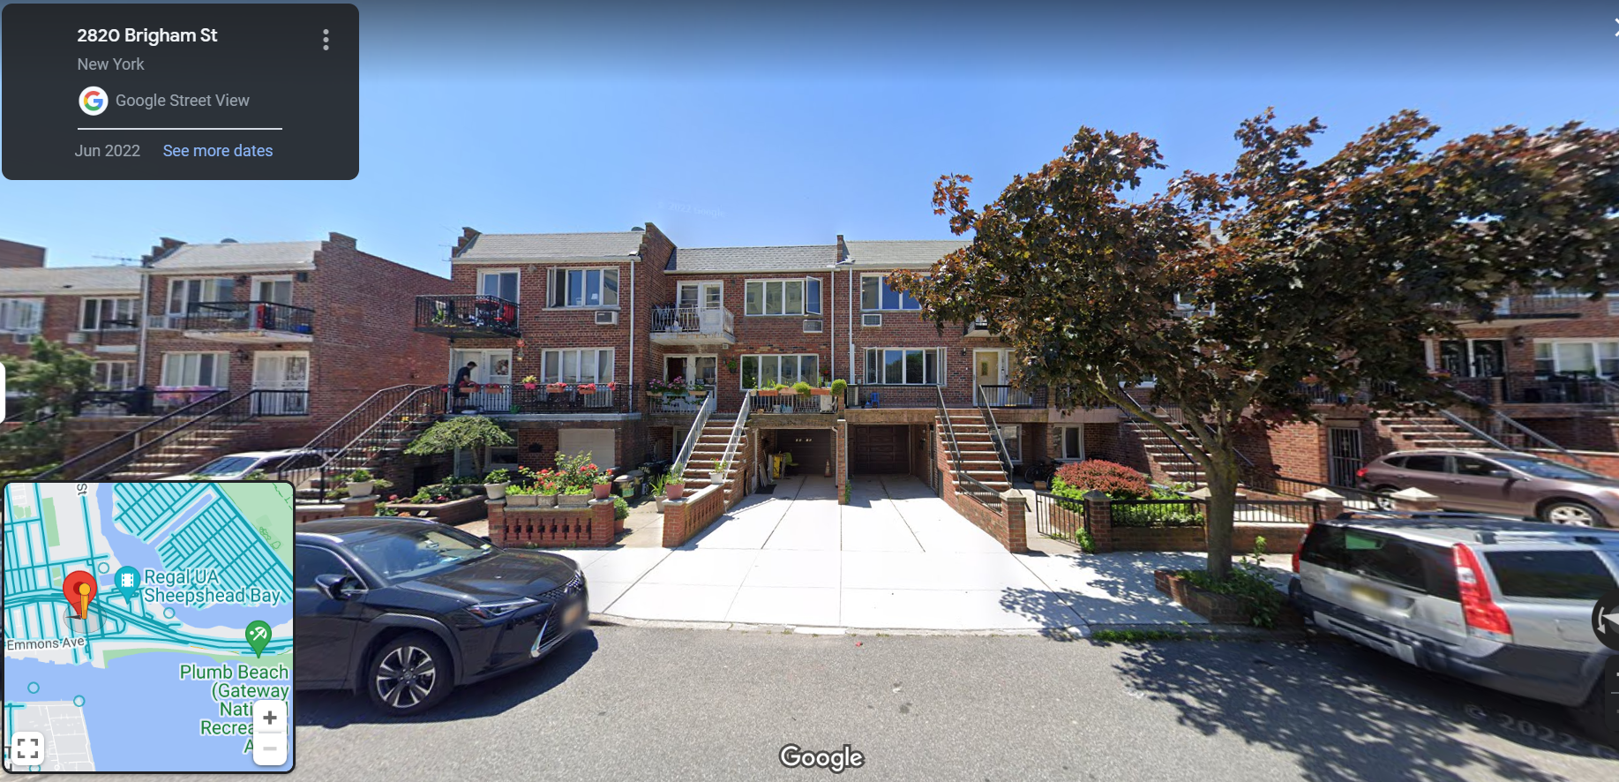
Sheepshead Bay, Brooklyn, NY

Slide 26
2nd Computer Crimes Response 10/9/2006
Responded to location FisheyeFox where was connected
Several Detective teams established surveillance of residence
Wireless Site Survey Initially performed using NetStumbler (from a Windows PC) and Orinoco WIFI card with external Omni directional antenna- None Detected
Male subject approached from door of residence
Teams moved in made contact
Individual identified self as off-duty NYPD Officer assigned to local Pct.
Stated he was working all night, lived there with GF
Confirmed he had Internet connection
Explained he had just purchased wireless router and had “secured it with new Anti-Virus program”
We were invited inside to talk

Slide 27
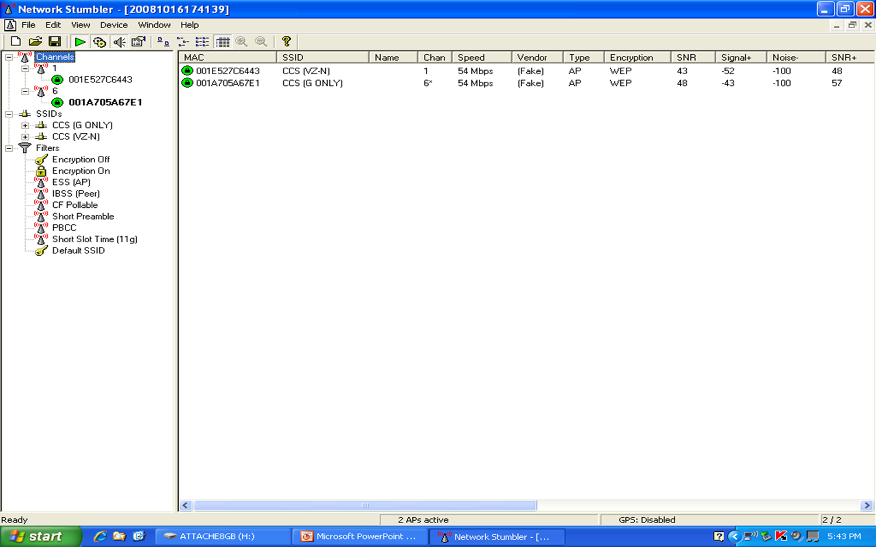
Net Stumbler WIFI Scan

Slide 28
Network Forensics
On kitchen table was new router and antivirus as claimed
Officer explained that they had one laptop and produced it
We were given consent to examine the computer and router
I connected via ethernet cable to Linksys AP
Default PW for Router Web GUI (Admin:Admin), SSID: Lynksys
3 devices were assigned IP addresses via DHCP
My laptop, GF’s laptop, and one Unknown Device
Router Settings were documented via Screen Shots, Print-to-PDF, digital photographs, and Web Spider tool (Teleport Pro)
IEEE Organizationally Unique Identifier (OUI) Lookup of MAC Addresses: https://ouilookup.com/

Slide 29
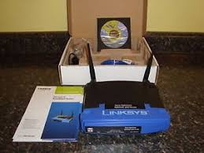

Linksys WRT-54G Wireless AP & Norton AntiVirus

Slide 30
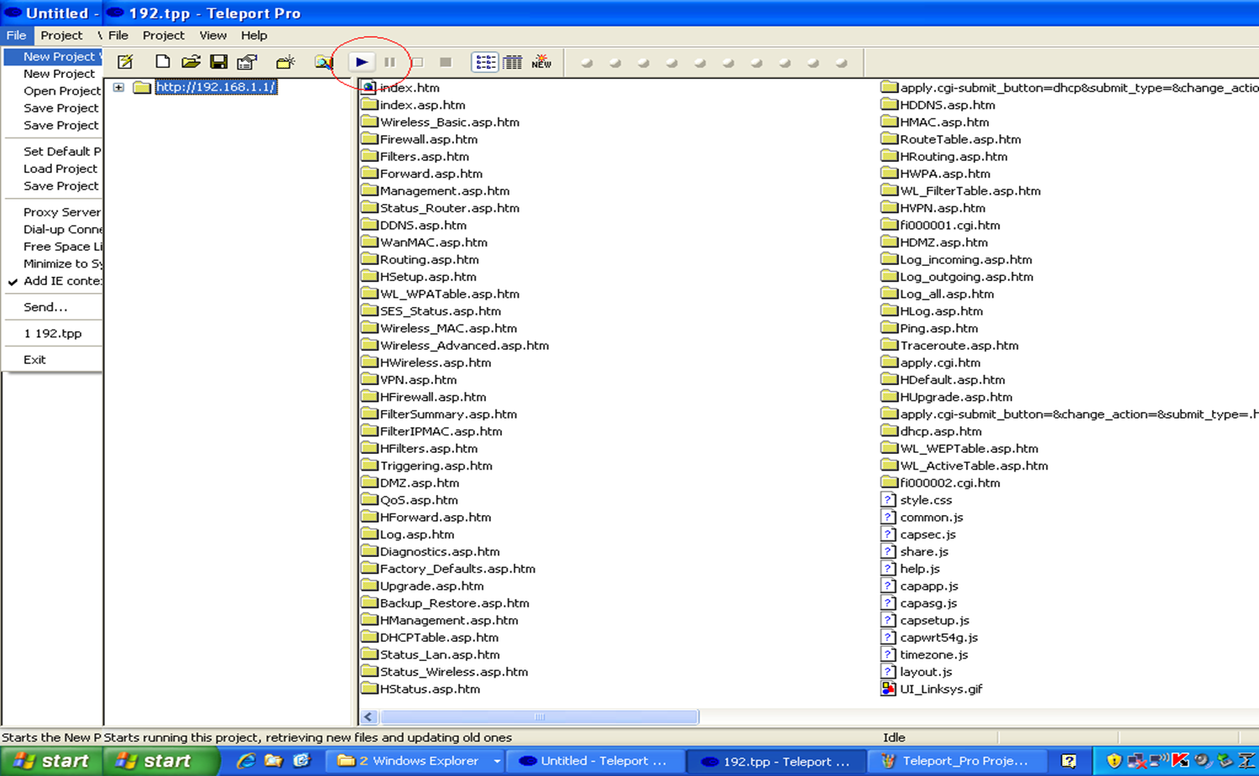
Teleport Pro Web Scraper

Slide 31
DHCP Review
Dynamic Host Control Protocol - RFC 2132, 1997
Automated service run on routers that manages connected devices and assigns IP Addresses, Subnet masks, Default Gateway, and DNS server settings
Attempts to maintain network stability- default lease time is 24 hours, with automatic renewal every 12 hours
*Specific to WRT-54G (set by vendor and user configurable)
Data maintained in tables that are accessible via the web console (or via terminal)

Slide 32
Undercover Chat with FisheyeFox
FisheyeFox AOL account was still logged in, possibly within feet
Employed scanning and sniffing tools to probe network
I was the working on my undergraduate CompSci Degree and was enrolled mid-semester in an advanced networking course.
Started unobtrusively trying to PING the rogue device, then went more active with NMAP and watched for potential traffic with Wireshark
With no local network generated from that IP, decided to go ‘hands-on’
Used an undercover AOL account to message FisheyeFox directly
He responded almost immediately – Light convo, mentioned he was back at school and had ‘PT’ in the morning (Physical Training)
Chat documented with logging tool (DeadAIM)

Slide 33
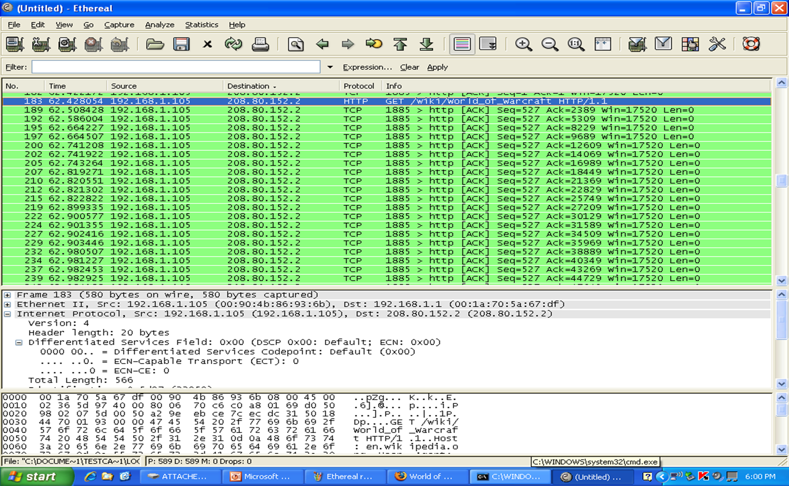
Wireshark Packet Analysis

Slide 34
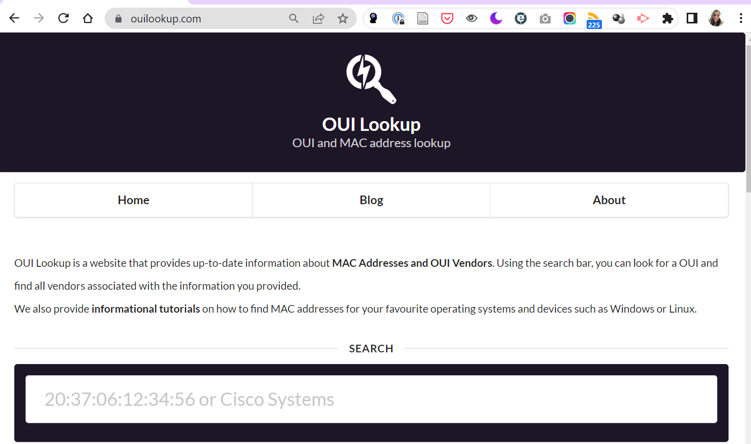
IEEE OUI Lookup

Slide 35
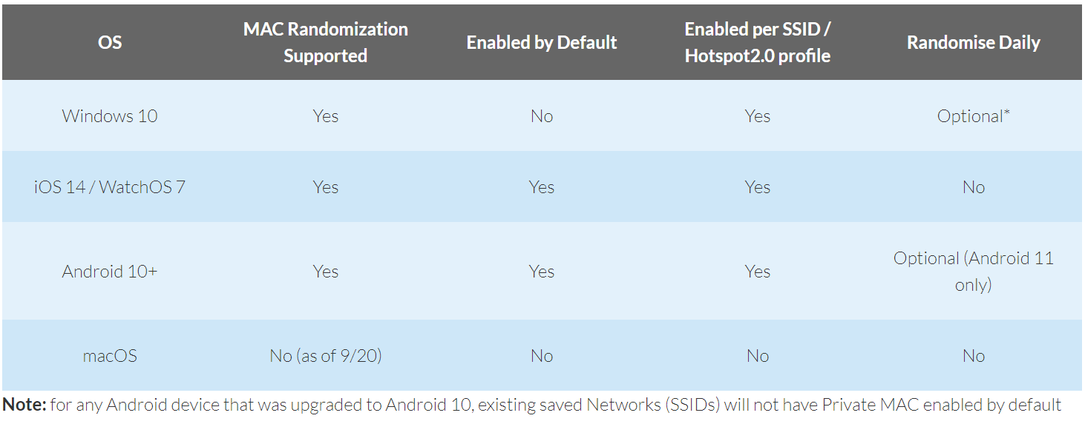
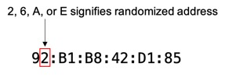
MAC Address Randomization

Slide 36
Network Investigation Exercise – 10/15 min.
MAC Address and OUI lookup
ID the MAC addresses and manufacturers of your PC’s WNIC, WAP (WIFI), and your smart phone
Run ipconfig /all and arp –a to get MACs
Wireless site survey
Download and install InSSIDer, examine available networks. Compare to what your phone shows.
Review the Linksys WRT-54G User Interface Simulator: https://ui.linksys.com/WRT54G/v8/8.00.0/basic.htm

Slide 37
3rd Computer Crimes Response 10/10/2006
While I was chatting with FisheyeFox, colleague was on phone with AOL After-hours Emergency Contact line
With Legal Documentation already served, they explained that FisheyeFox account had also been logged in from SUNY Maritime College – Public IP Address
Detective teams responded to the Bronx and liaised with campus PD
John Fox was located in his dorm room and returned to 61 with Precinct Squad Detectives
Fox’s desktop PC from his dorm room was secured and later brought to CCS once a search was secured by case Detectives

Slide 38
IP Chicken

Slide 39
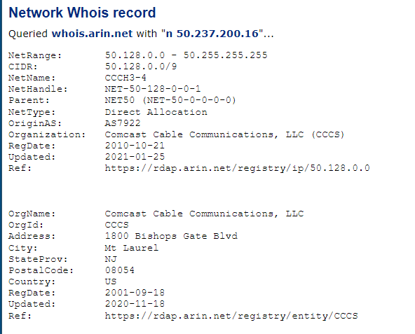
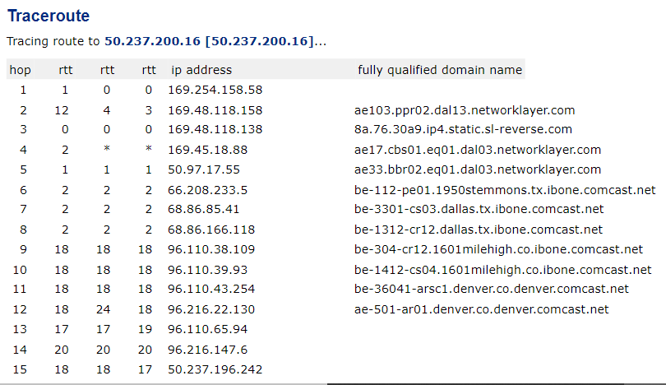
Central Ops

Slide 40
Internet Investigation Exercises 5 min.
Investigate the Hotel ISP
Utilize Online recon tools such as IP Chicken, Central Ops
Investigate Another Website of your Choice

Slide 41
4th Computer Crimes Response 10/10/2006
John Fox was questioned that day and eventually placed under arrest by Precinct Squad Detectives
Additional subjects were identified through traditional investigative techniques- interrogations, interviews, etc.
Called the following day to assist with the execution of a Search Warrant two doors down from off-duty PO
Residence of Anthony Fortunato, acquaintance of John Fox
Looking for wireless enabled PC, among other evidence
Attorney representation at residence

Slide 42
‘Smoking Gun’ Laptop Located
Attorney offered the “only” laptop Family had
Not Dell and MAC didn’t match DHCP Log
Dell Laptop located hidden in the basement garage
MAC Address was physically located on the laptop
Wireless NIC contained in accessible compartment
Sticker affixed to NIC card located in device
MATCHED the MAC from DHCP Client Table

Slide 43
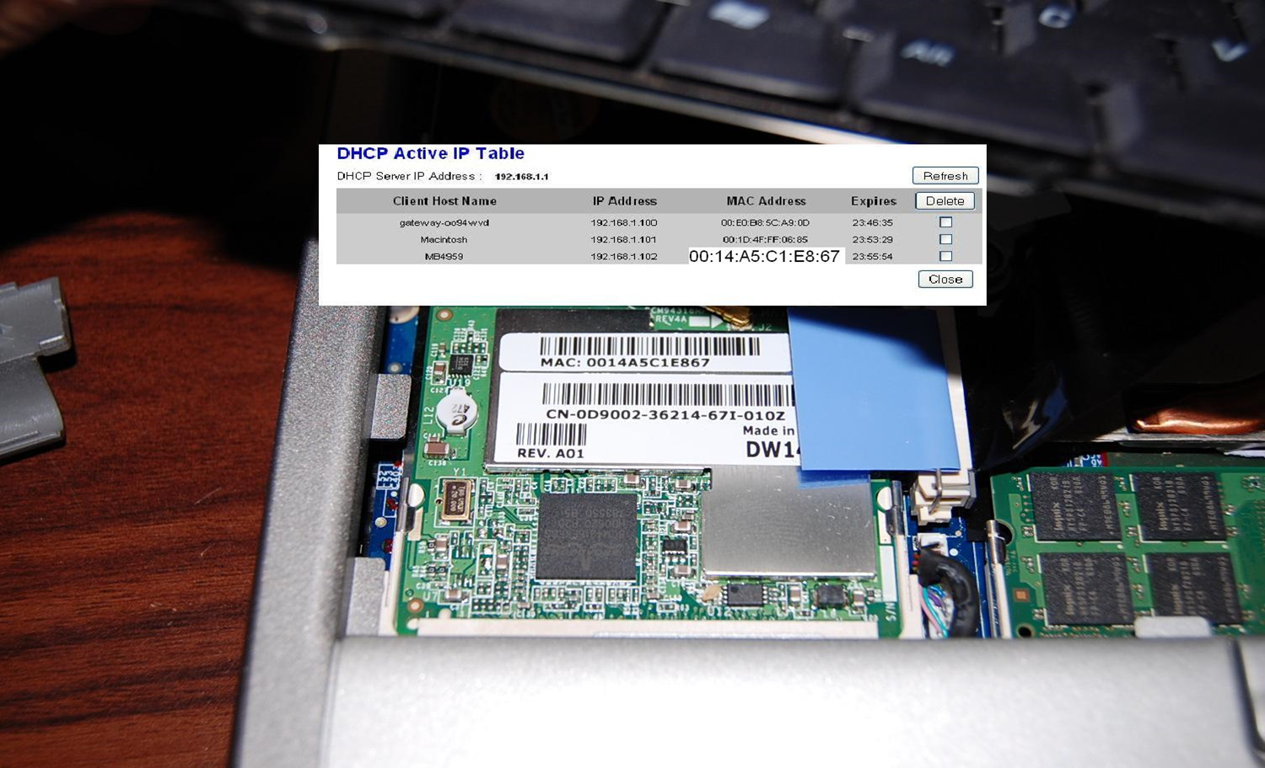
DHCP Table matches Laptop Physical MAC
* Simulated for demonstration purposes.

Slide 44
Follow-Up Wireless Scan
Open wireless AP signal from off-duty PO was available from the Fortunato residence in basement
Examination of the Router and DHCP Tables no longer showed any record of the Dell Laptop- 24Hr. Lease Expired!
Record of PD computer still available

Slide 45
Arrests of all Four Participants
Defendants charged with Assault, Attempted Robbery as a hate crime. Upgraded charges of Second-Degree Murder were added after Michael died.
They targeted Michael because he was gay. They believed he was less likely to fight back or even report the crime.
John Fox, 19. His screen name was used, and he spoke to Michael in person and went with him in the car to the beach.
Anthony Fortunato, 20. Conceived the plan, they were at his house on the computer, and they all went back there after the 1st meeting and the attack.
Ilya Shurab, 20. Tagged along at the first meeting, then attacked Michael at the beach. Dragged him to shoulder and rifled through his pockets
Gary Timmons, 16. Went along with the plan, but fled early and cut deal.

Slide 46
Analysis of Memory Dump – Sandy’s PC
DD image of Memory created during on scene analysis
Analyzed with standard forensic tools
Incomplete fragments of chat located- minus final lines stating “…see you in 20 minutes…”
Converted to a .DAT file and analyzed with NetAnalysis
MapQuest URL that resolved to driving directions from his Residence to Crime Scene

Slide 47
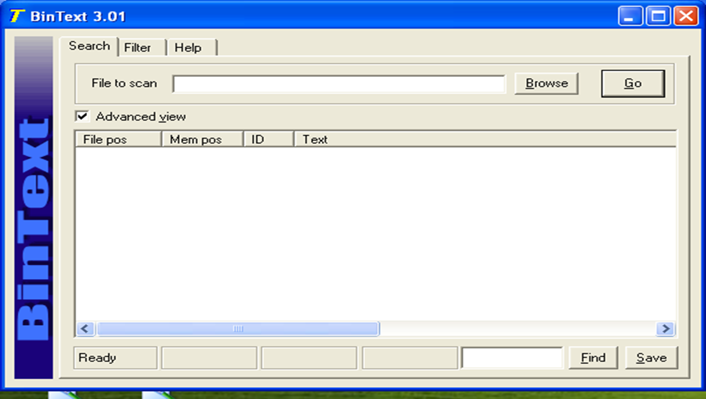
BinText for Manual Memory Analysis

Slide 48
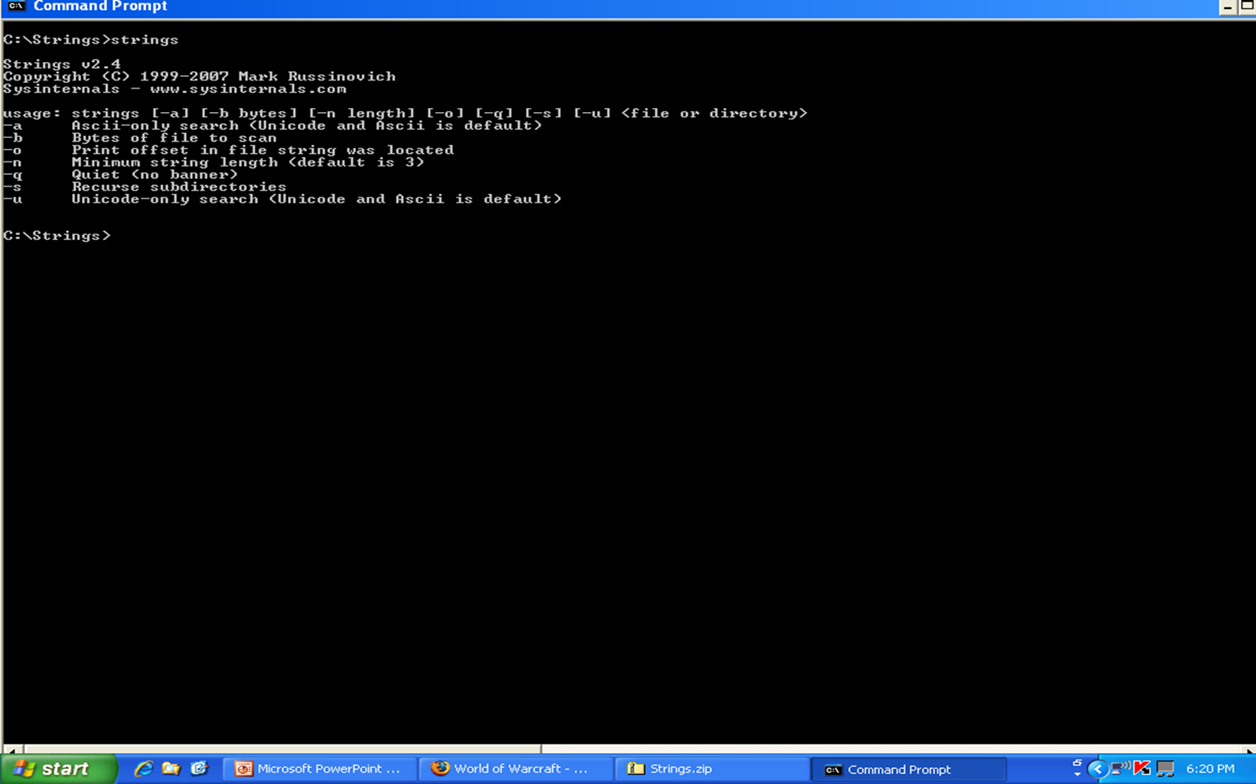
Strings.exe for Manual Memory Analysis

Slide 49
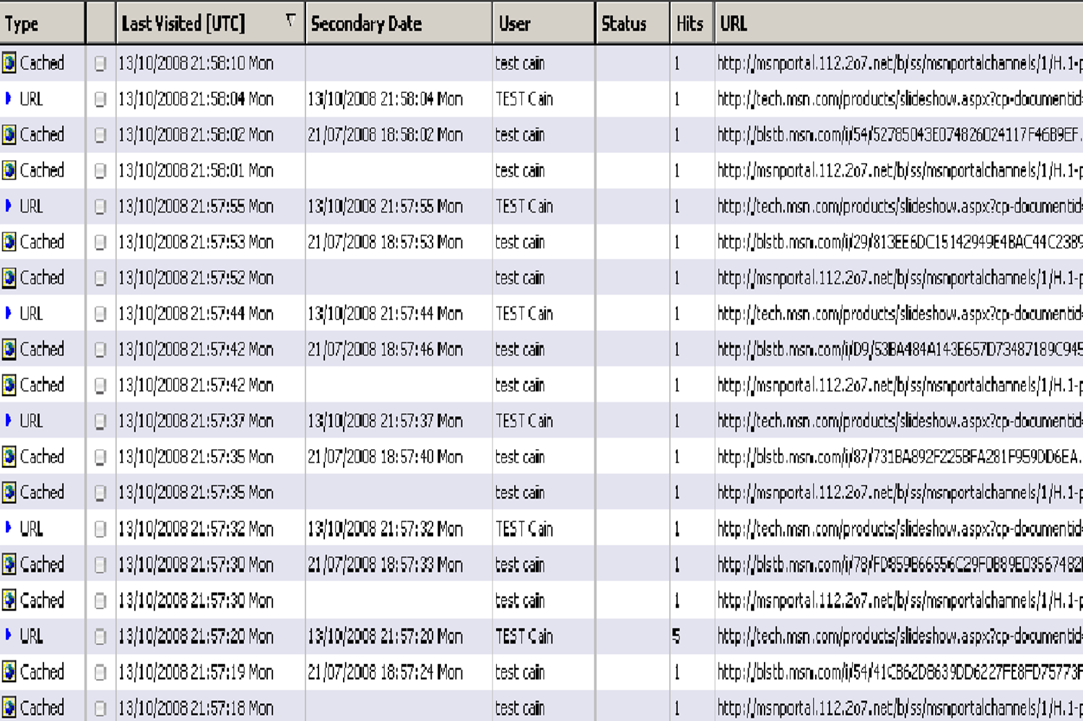
Net Analysis, for Internet History from RAM

Slide 50
Static Forensic Exam– Sandy’s PC
Victim’s Home Computer
Many chats saved- seemed to know risks
Email archived on machine
Even more incomplete fragments of chat located- minus additional final lines
Fragments of earlier chats with FisheyeFox were located

Slide 51
Static Forensic Exams, cont.
John Fox’s Desktop Computer (from dorm room)
Showed ownership of AOL account used
Contact from U/C account recovered
Anthony Fortunato’s Laptop Computer (hidden in basement)
Used to chat with the victim, chats recovered
Additional chat accounts identified, potential victims
Browser and email history located

Slide 52
Trial 9/10/2007
John Fox and Anthony Fortunato were tried together with 2 separate juries.
Numerous witnesses testified, including Detectives from the Precinct Squad, Homicide Squad, and Hate Crimes Squad.
Three Detectives from Computer Crimes also testified, including myself.
For my testimony, I was designated a Court-Certified Expert in Computer Security, Computer Crime Investigations, and Computer Forensics.

Slide 53
Trial Twist
The Defendants were charged with hate crimes, which basically doubled the length of any potential sentences.
Defense attorneys argued that the case was just a larceny gone wrong and that no ‘hate’ was involved.
It was also argued that the hit and run driver was the person at fault. Again, irrelevant, because Michael was killed while the were robbing him.
Fortunato came out publicly as gay, even testifying that he did not hate gay people, because was a member of that community. Three men who had paid him for sex were subpoenaed to testify to prove his gayness.
The Judge and Jury correctly disregarded these claims, because under the law, if a person or group is targeted because they are in a protected class (gender, race, sexuality, etc.) for ANY reason, it becomes a hate crime. Targeting Sandy, because he was gay, even though it was because (they believed) he wouldn’t fight or report the incident, exactly met the definition.
.

Slide 54
Convictions and Sentences
Fox and Fortunato were convicted by their juries after 1 month trial. Shurov subsequently plead guilty. Timmons plead guilty as part of deal where he had to testify against the other three, for reduced sentence.
Fox - Manslaughter, Att. Robbery 1st and 2nd Deg. All counts were as Hate Crimes. (13-21 Yrs.) Released in Nov. 2017.
Fortunato - Manslaughter as a Hate Crime and Att. Petit Larceny.
(7-21 Yrs.) Paroled in 2015.
Shurov - Plead Guilty to Manslaughter and Att. Robbery as Hate Crimes. (17 ½ Yrs.) Released in late 2021.
Timmons - Plead Guilty to Att. Robbery as a Hate Crime. He cooperated. (4 Yrs.)

Slide 55
Conclusions / Lessons Learned
Live Acquisitions are volatile, but can yield valuable evidence
Practice on multiple Platforms
Building relationships with ISPs is invaluable. Post incident follow up and feedback with ISPs helps with future cooperation
Have as many tools available as you can afford- Best chance for success. Both open source and commercial.
One and only one chance to retrieve data.
Document all your actions.
Need strong team work.

Slide 56
Computer Crime Squad Procedures Modified
Wireless site surveys became standard policy for all pre-search warrant reconnaissance operations.
This reinforced and further showed that extremely valuable evidence was recoverable from these digital crime scenes,
This was first case in NYC that we were able to physically link a device to an unrelated open unsecured wireless network via the MAC. It was especially significant because it such a serious, high-profile case.
We contracted Helix developer to fully train the entire squad on live device and RAM analysis.

Slide 57
Media Coverage
All local NYC Television and Newspapers at time of incident and then again during the trial
Television
Grave Mysteries: Episode 8- Death on the Highway (4/1/2019)
True Crime Series (TBA, Oxygen Network): - In Production
Podcasts
Today in True Crime: October 8, 2006: Michael Sandy Killed (10/8/2021)
THRE3: A True Crime Podcast: Episode 80 (7/7/2022)
Criminal Musings: Episode 5- The Murder Of Michael Sandy (11/16/2017)
Cereal Killerz: Episode 4- Michael Sandy (1/13/2023)

Slide 58
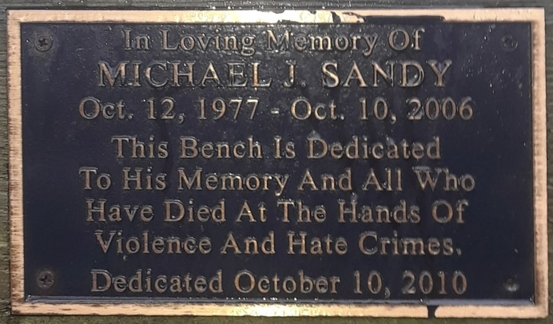

Slide 59
IRB-Approved Attendee Survey
University Institutional Review Boards (IRB) assess any academic research that involves human subjects.
The participant's involvement is entirely optional, anonymous, and voluntary.
The purpose of this research is to study what benefits you may have received from attending our talk here today.
We posted a link to a short Qualtrics participant survey for open-ended feedback. The link is on the Github page.

Slide 60
Contact Info and Questions
Prof. Denise Dragos
dragosd@stjohns.edu
Dr. Suzanna Schmeelk
schmeels@stjohns.edu

